Slide 1
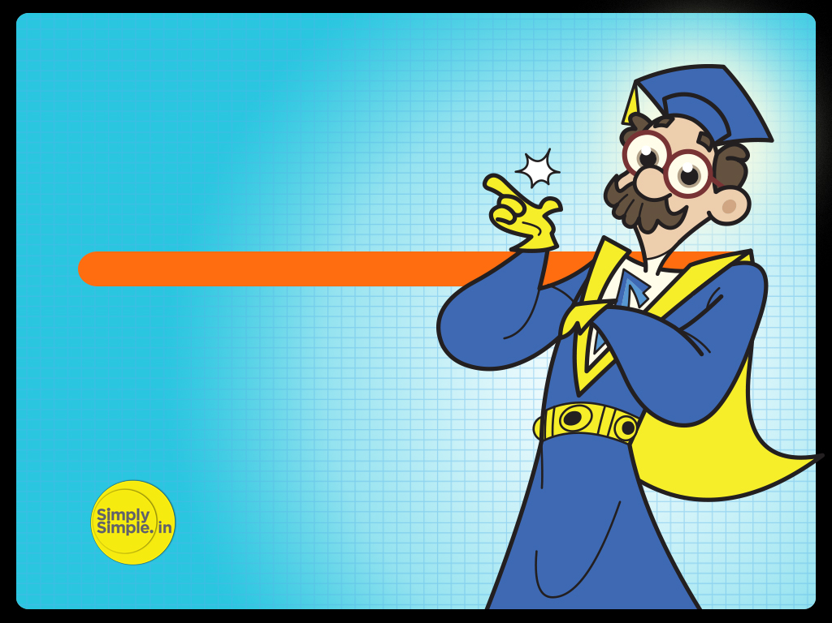

FED TAPERING
GOODS & SERVICE TAX

Slide 2
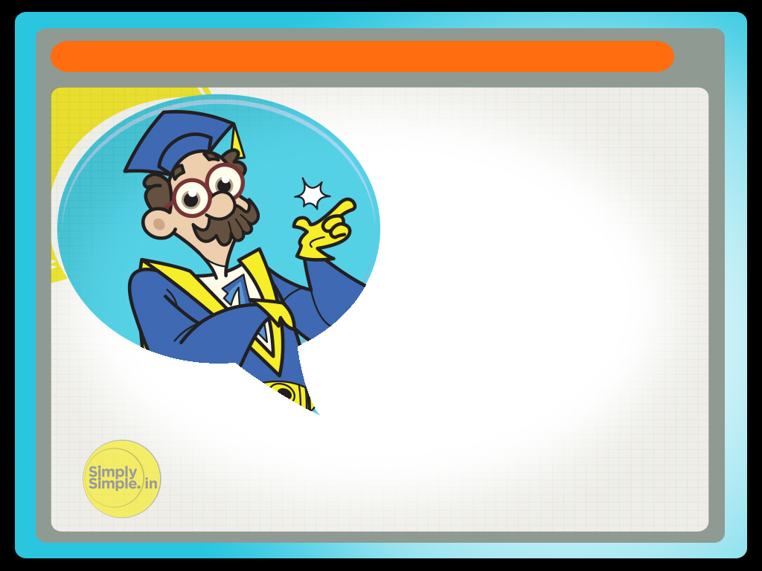
GOODS & SERVICE TAX
The Finance Minister of India, Mr. Pranab Mukherjee in his Union Budget 2010 had come up with a string of reforms including the GST (Goods and Services Tax).

Slide 3

GOODS & SERVICE TAX
While GST is successfully implemented in countries like Brazil and China, it is somewhat new to India and requires huge operational and administration efforts.

Slide 4

GOODS & SERVICE TAX
So what is GST?
GST means Goods & Service Tax.
How does it make life simpler?
Let me explain…

Slide 5

Understanding GST – By Prof. Simply Simple TM

Slide 6
GOODS & SERVICE TAX
Let’s take a look at Mr. A.
He owns a leather factory in Maharashtra.
He sells raw leather worth Rs.10,000 to Mr. B.
Mr. B provides a value addition to the leather by tanning it.
After doing so, Mr. B sells the tanned leather to Mr. C for Rs.12,000.

Slide 7
GOODS & SERVICE TAX
Mr. C stitches the tanned leather into a shoe & sells the finished product to the retail shop at Rs.15,000.
Now, in the absence of GST, each of these parties would have to pay taxes on union excise duties, customs duties, service tax and state VAT “individually”.
But the GST aims to eliminate multiplicity of these taxes & integrate them under one head.
It includes CENVAT, Additional Excise Duties, Service Tax, Surcharges, Cesses, Octroi among others at the Central Level & State VAT, Luxury Tax, Entertainment Tax among others at the State Level.

Slide 8
GOODS & SERVICE TAX
But with the advent of GST, a proposed standard rate of 20% would be charged from MR. A, Mr. B & Mr. C “collectively” in the first year.
Out of this 20%, 10% would go the Central Govt. (CGST) & 10% would go to the State Govt. (SGST).

Slide 9
GOODS & SERVICE TAX
So now, when Mr. A sells leather worth Rs.10,000 to Mr. B he is taxed 20% i.e. Rs.2,000.
Mr. B provides value addition to the process by tanning & sells the tanned leather to Mr. C for Rs.12,000.

Slide 10
GOODS & SERVICE TAX
In the absence of GST, when Mr. B sells the tanned leather to Mr. C he would have been taxed 20% too individually.
He would then need to pay tax of Rs.2,400 (20% of Rs.12,000).
However with the advent of GST, when Mr. B sells the tanned leather to Mr. C he will be taxed 20% but will get credit on the tax paid by Mr. A.
As Mr. A has already paid Rs.2000, Mr. B would then need to pay tax of
Rs.2,400 - Rs.2,000 = Rs.400 only.

Slide 11
GOODS & SERVICE TAX
Now similarly, when Mr. C sells the stitched shoe to the retail shop, his selling price is Rs.15,000. Without GST, he would have been taxed 20% on Rs.15,000 & would have to pay tax of Rs.3,000.
But since he gets credit on the tax paid by Mr. A (Rs.2,000) & Mr. B (Rs.400) he pays tax of just Rs.600 (Rs.3,000 - Rs.2,400).

Slide 12
GOODS & SERVICE TAX
Thus, GST would remove the hassle of filing & claiming refunds for individual taxes later on for manufacturers, which would greatly improve the cash flow situation for producers of goods and services.

Slide 13
GOODS & SERVICE TAX
Thus, by merging all levies on goods and services into one, GST acquires a very convenient and transparent character.

Slide 14
GOODS & SERVICE TAX
One more advantage of GST is that earlier if a manufacturer had to set up his plant, he would look at a city/state where the state tax was less.
For e.g. today, Mr. A would set up a plant in Tamil Nadu even if his target market was, say, Punjab because, after accounting for transportation costs too, it might still be cheaper to run this plant from TN.

Slide 15
GOODS & SERVICE TAX
But after GST comes in, Mr. A will find that the tax laws are the same all over the country.
He would then be free to set up his plant where his target audience is.

Slide 16
GOODS & SERVICE TAX
This saving will then be passed on to you leading to lower operating costs for businesses and lower prices for consumers.

Slide 17
GOODS & SERVICE TAX
One important thing to note: the current VAT system does not include services but the GST will include Goods & Services, when it is introduced.

Slide 18
GOODS & SERVICE TAX
Hope you have now understood the concept of GST

Slide 19
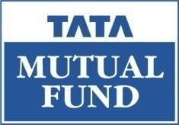
Do write to me at
professor@tataamc.com

Slide 20

DISCLAIMER
The views expressed in this lesson are for information purposes only and do not construe to be any investment, legal or taxation advice. The lesson is a conceptual representation and may not include several nuances that are associated and vital. The purpose of this lesson is to clarify the basics of the concept so that readers at large can relate and thereby take more interest in the product / concept. In a nutshell, Professor Simply Simple lessons should be seen from the perspective of it being a primer on financial concepts. The contents are topical in nature and held true at the time of creation of the lesson. This is not indicative of future market trends, nor is Tata Asset Management Ltd. attempting to predict the same. Reprinting any part of this material will be at your own risk. Tata Asset Management Ltd. will not be liable for the consequences of such action.
Mutual Fund investments are subject to market risks, read all scheme related documents carefully.

